Slide 1
Meeting Week 9
Last week summary
  Research Plan was discussed
  FP LTI baseline python implementation comparison with MATLAB
Discussed with Roland last monday
  Gantry model
  FP-LPV baseline in LFR format
    M(Y) invertibility
    LFR format
    Well-Posedness
    Internal feedback within the LFR (due to invertibility not an Algebraic loop)
      Problem with Jan’s code and possible workaround
SVD for dimension reduction of the latent signals
  Roland proposed 2 methods
  Numerical validation
Outline ToDo next week

Slide 2
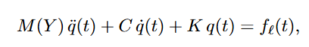
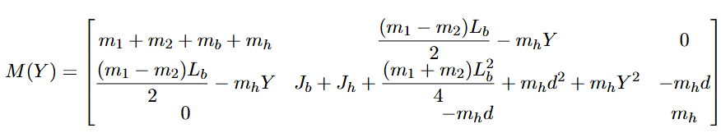
Last week summary
Currently working on converting the FP-LPV baseline into LFR format
Last week discussed:
  Frozen LTI baseline verification in python
  Need to check M(Y) is invertible
  Need to convert to LFR format
  Proposed feedforward in simulation

Slide 3
Invertibility
Discuss model. Clearly explain what is q, how is the model constructed. Maybe an image of the dual-gantry? But then I need to understand it quite well
  Remember coulomb not modeled
  State for example the coordinates of Y (same for X1 X2 or theta) How is it derived? Mainly should be talking about what the current model represents.
  Explain Logical coordinates and …, then its also clear why we call them these.
LPV-LFR construction
Ask about which coordinates to use? Matlab use the logical so I used that → impact on input output? Or should I transform?

Slide 4
FP-baseline model
Gantry system
Equations of motions
MATLAB State-Space implementation

Slide 5
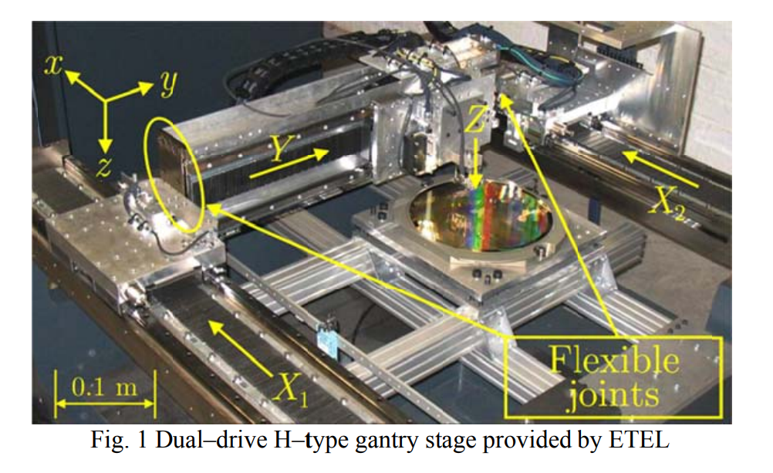
This figure shows the physical dual-drive gantry stage from Garcia. Two parallel X-actuators, X1 and X2, move the cross-arm, and a third actuator moves the payload along the Y axis. In the model, the payload and tool-point mass are lumped together, and small desynchronization between X1 and X2 is allowed through flexible joints.
3-DOF
This is the dual-drive H-type gantry from Garcia. The two parallel drives are X1 and X2, and the payload carriage moves along the beam in Y

Slide 6
The tool-point: working point of the machine:;the part mounted on the moving Y carriage that actually performs the task.
In this gantry, that could be:
Z actuator
Camera
Pick-and-place head
The Y carriage mass and tool-point mass are combined into one lumped mass m_h
This figure shows the physical dual-drive gantry stage from Garcia. Two parallel X-actuators, X1 and X2, move the cross-arm, and a third actuator moves the payload along the Y axis. In the model, the payload and tool-point mass are lumped together, and small desynchronization between X1 and X2 is allowed through flexible joints.
3-DOF
This is the dual-drive H-type gantry from Garcia. The two parallel drives are X1 and X2, and the payload carriage moves along the beam in Y

Slide 7
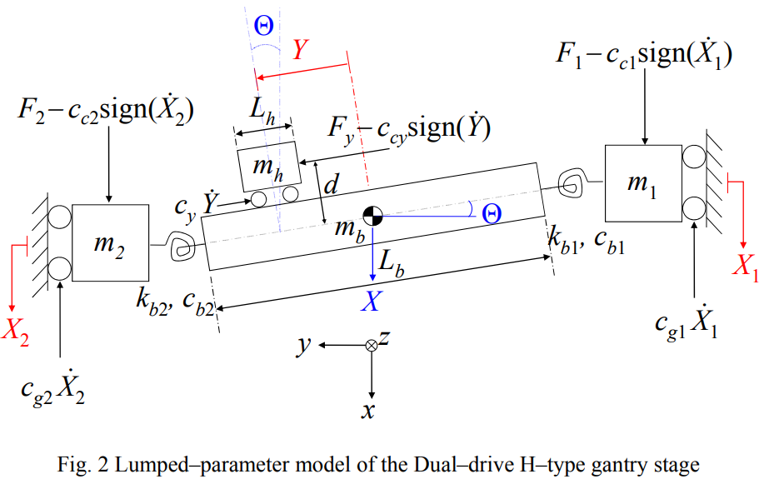
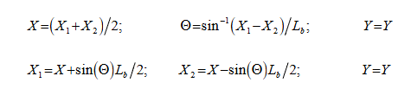
Stage coordinates: [X1, X2, Y]
Logical coordinates: [X, Θ, Y]
X = one scalar coordinate, the translation of the cross-arm
Θ = one scalar coordinate, the yaw angle of the cross-arm
Y = one scalar coordinate, the carriage displacement along the beam, measured from the beam center
≈ (X1 - X2)/Lb
Notes:
X1, X2, and Y are measured stage coordinates; after transformation, X and Θ replace X1 and X2, while Y stays the same.
Stage coordinates are the directly measured actuator positions:
X1: left X-actuator position
X2: right X-actuator position
Y: payload carriage position along the beam
Logical coordinates are motion-based coordinates that describe the gantry more physically:
X: average translation of the cross-arm
Θ: yaw/skew of the cross-arm
Y: same payload carriage position
So the difference is:
Stage coordinates describe what the encoders on the machine read.
Logical coordinates describe the underlying rigid-body motions of the gantry.

Slide 8
Stage coordinates: [X1, X2, Y]
Logical coordinates: [X, Θ, Y]
X = one scalar coordinate, the translation of the cross-arm
Θ = one scalar coordinate, the yaw angle of the cross-arm
Y = one scalar coordinate, the carriage displacement along the beam, measured from the beam center
Note Jasper ASMPT:
  Garcia’s lumped model allows a small yaw of the cross-arm through compliance and slight desynchronization of the two X drives. The beam itself is directly constrained by rigid walls: not correctly drawn.
Notes:
X1, X2, and Y are measured stage coordinates; after transformation, X and Θ replace X1 and X2, while Y stays the same.

Slide 9
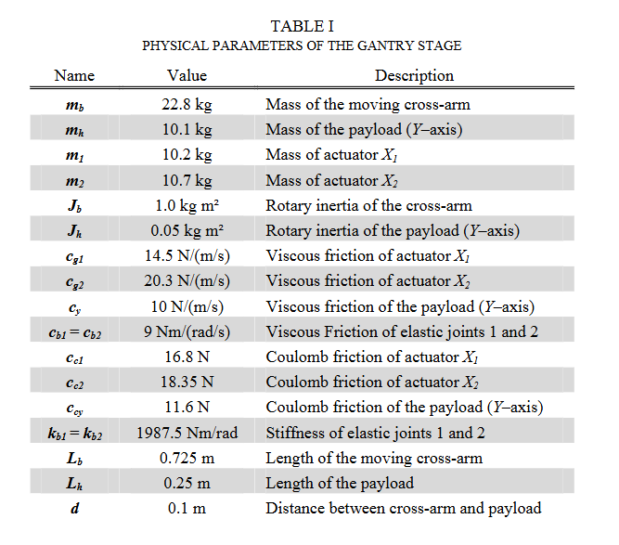

Slide 10
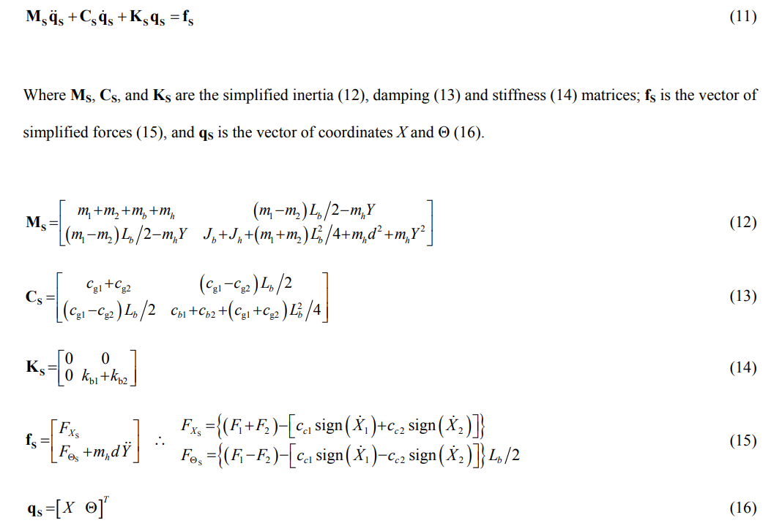
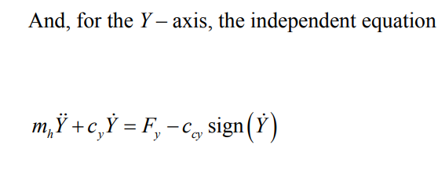
Simplified motion equations

Slide 11
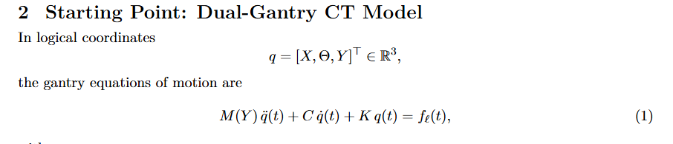
MATLAB implementation
Using the MATLAB Symbolic Toolbox, the full nonlinear Euler-Lagrange equations were converted into a 6-state model, while the simplified 6-state baseline realization was obtained analytically from the second-order M(Y), C, and K matrices.
  Garcia’s independent Y-axis equation is absorbed into the third row of the coupled 3x3 model; it is no longer independent, and the Coulomb-friction term is omitted in the state-space baseline.
Notes:
Because the three generalized motions X, Θ, and Y are not dynamically independent.
In the model:
moving the payload along Y changes the inertia seen in X and Θ
rotation Θ and payload motion Y are coupled through the offset d
the cross-arm translation/rotation and payload motion all belong to the same mechanical system
That is why the inertia matrix is a full 3x3 matrix instead of three separate scalar equations.

Slide 12
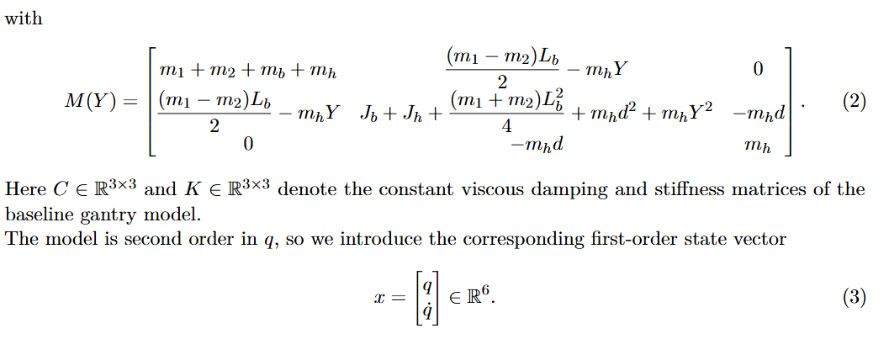
MATLAB implementation
Notes:
That line means: take the plant derived in logical coordinates and express its inputs and outputs in stage coordinates.
So:
sys is the model in logical coordinates
left multiplication by P.' converts the outputs
[X, Θ, Y] -> [X1, X2, Y]
right multiplication by P converts the inputs/forces
[F_X1, F_X2, F_Y] -> [F_X, F_Θ, F_Y]
So StageCoordinatesSystem = P.' * sys * P is an I/O coordinate transformation, not a new physics model.
What changes mathematically:
A stays the same
B becomes B_stage = B_logical P
C becomes C_stage = P.' C_logical
D becomes D_stage = P.' D_logical P
For your slides: skip the MATLAB code line itself, but do not skip the idea.
Say it in one sentence like this:
“We derive the physics in logical coordinates for clarity, then transform the model to stage coordinates so it matches the measured actuator signals [X1, X2, Y].”

Slide 13
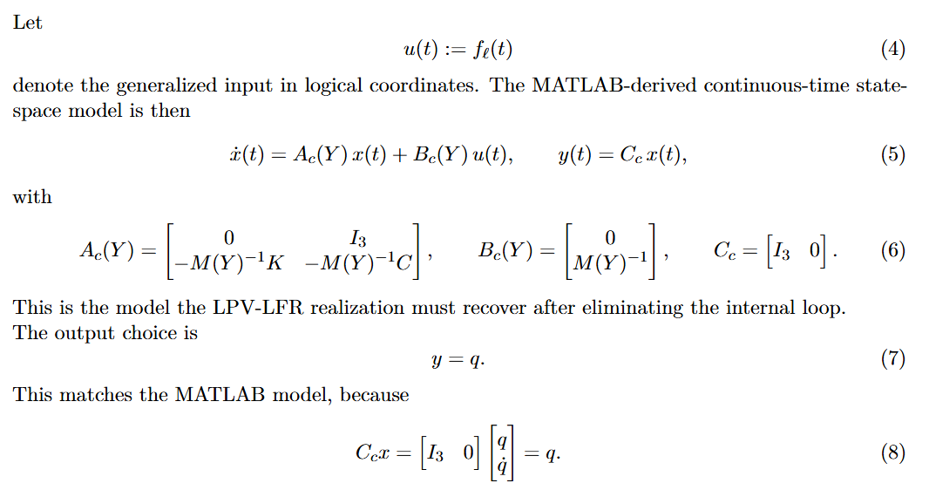
MATLAB implementation
Notes:
That line means: take the plant derived in logical coordinates and express its inputs and outputs in stage coordinates.
So:
sys is the model in logical coordinates
left multiplication by P.' converts the outputs
[X, Θ, Y] -> [X1, X2, Y]
right multiplication by P converts the inputs/forces
[F_X1, F_X2, F_Y] -> [F_X, F_Θ, F_Y]
So StageCoordinatesSystem = P.' * sys * P is an I/O coordinate transformation, not a new physics model.
What changes mathematically:
A stays the same
B becomes B_stage = B_logical P
C becomes C_stage = P.' C_logical
D becomes D_stage = P.' D_logical P
For your slides: skip the MATLAB code line itself, but do not skip the idea.
Say it in one sentence like this:
“We derive the physics in logical coordinates for clarity, then transform the model to stage coordinates so it matches the measured actuator signals [X1, X2, Y].”

Slide 14
Then MATLAB converts that second-order model into a first-order 6-state realization:
Then MATLAB converts that second-order model into a first-order 6-state realization:
x = [q; qdot] = [X, Θ, Y, dX, dΘ, dY]^T
so A becomes 6x6 and B becomes 6x3
In the state-space model, they do not build f explicitly anymore; they just call the net input u

Slide 15
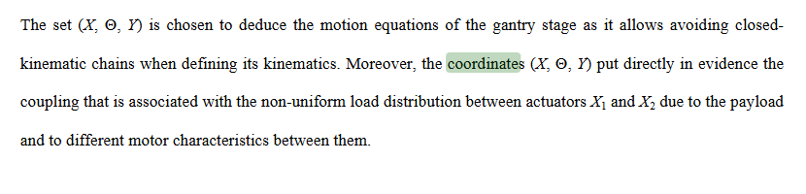
Y representation
Logical coordinates and
StageCoordinatesSystem = P.'*sys*P;
["Stage coordinates", "Logical coordinates", "Modal coordinates"];
Het uiteindelijke resultaat moet overeen komen met de Ax Bu matrices die ik gebruik.

Slide 16
Y is not the full Cartesian (x,y,z) position of the payload. In this model, Y is a single scalar generalized coordinate: the position of the payload carriage along the cross-arm / Y-axis, measured relative to the center of the beam. The repo notes this explicitly: Y = 0 is at the beam center, and positive/negative Y means moving to one side or the other of that center line; see
Y does not mean the payload can independently move in x, y, and z.
Y means only: “where is the payload carriage along the cross-beam?”
The model has 3 mechanical DOFs: X, Θ, and Y.
payload position in workspace = result of several coordinates together
Y is the payload carriage displacement along the beam, not the full Cartesian position of the payload.

Slide 17
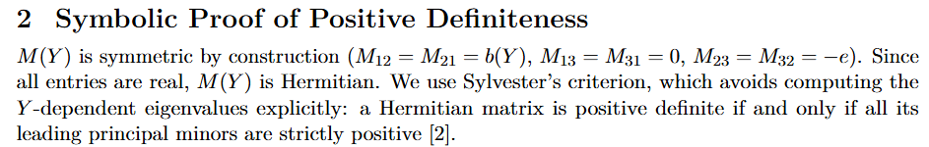
M(Y) invertibility
Holds for all Minor 1, 2 and 3 for the 3x3 symmetric matrix
→ Invertible

Slide 18
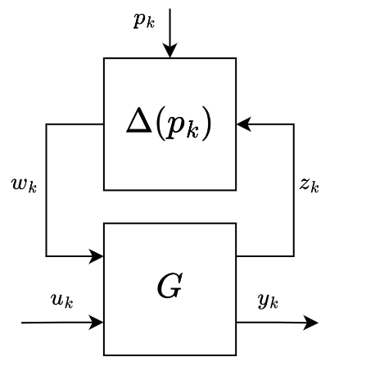
LPV-LFR structure

Slide 19
LPV-LFR structure
Symbol | Meaning
p_k | Scheduling variable
u_k | External input
y_k | System output
z_k | Internal output (G → Δ)
w_k | Internal input (Δ → G)
Block | What it is
G | Constant interconnection matrix: all dynamics, no P-dependence
Δ(p_k) | Scheduling block: all P-dependence isolated here

Slide 20
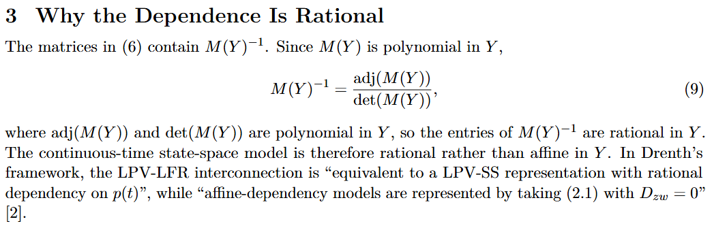
LPV-LFR derivation

Slide 21
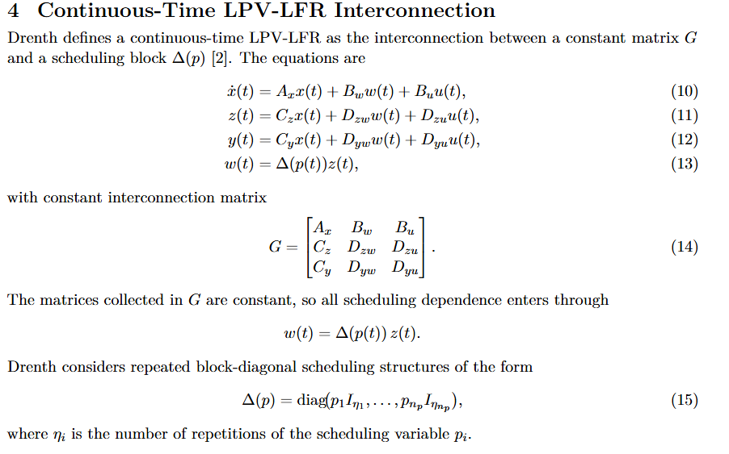
LPV-LFR derivation

Slide 22
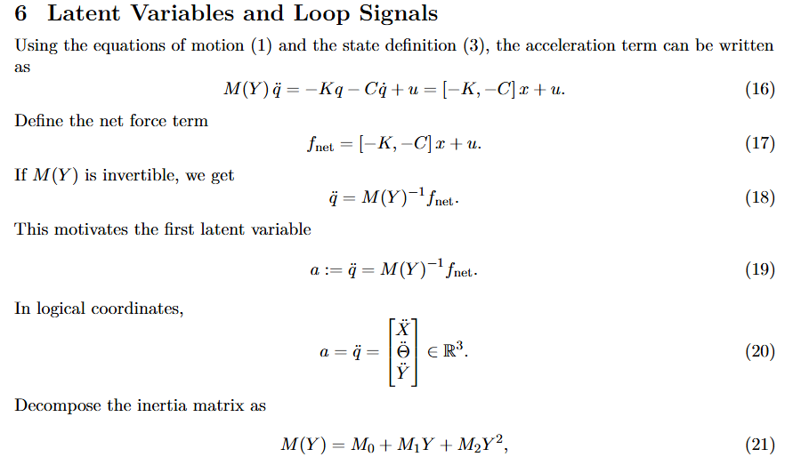
LPV-LFR derivation

Slide 23
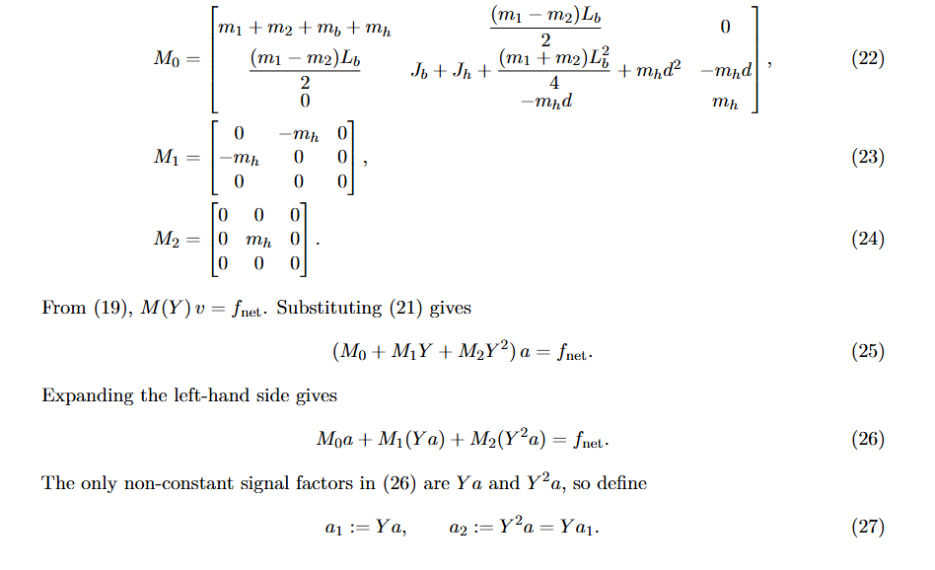
LPV-LFR derivation

Slide 24
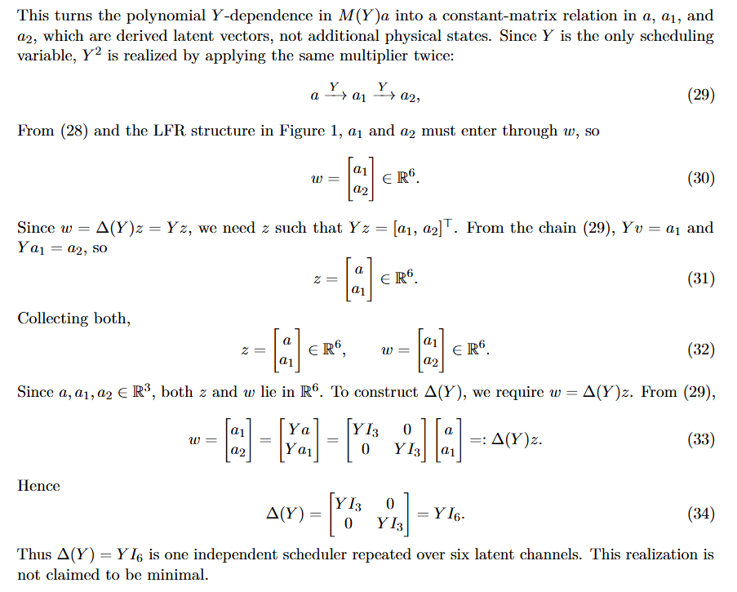
LPV-LFR derivation

Slide 25
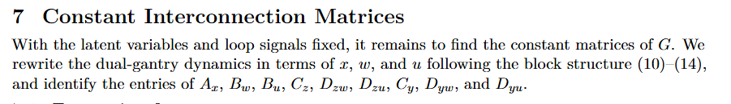
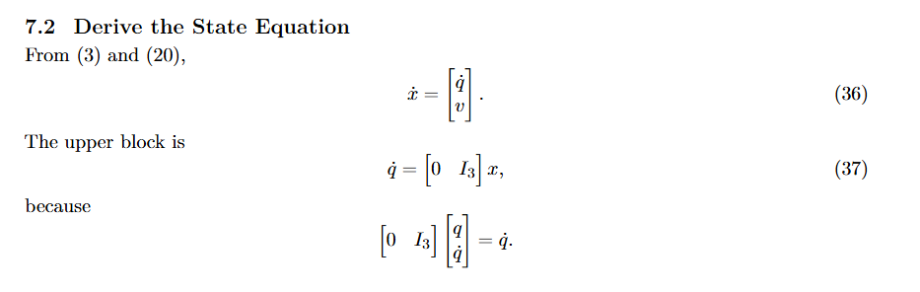
LPV-LFR derivation

Slide 26
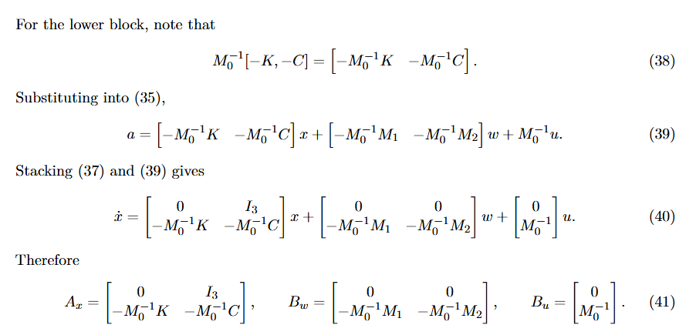
LPV-LFR derivation

Slide 27
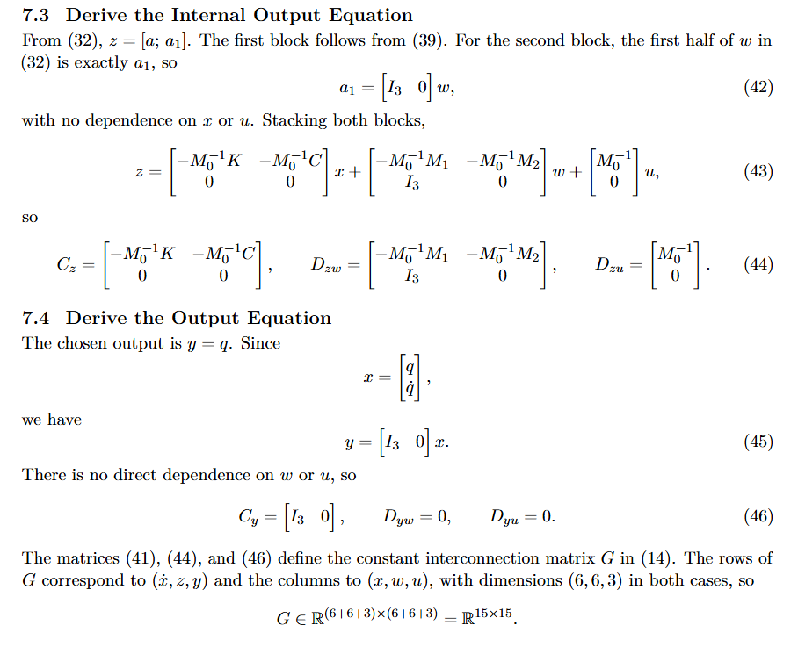
LPV-LFR derivation

Slide 28
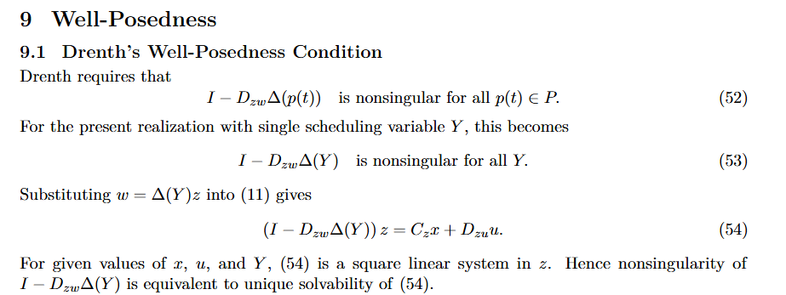
LPV-LFR derivation

Slide 29
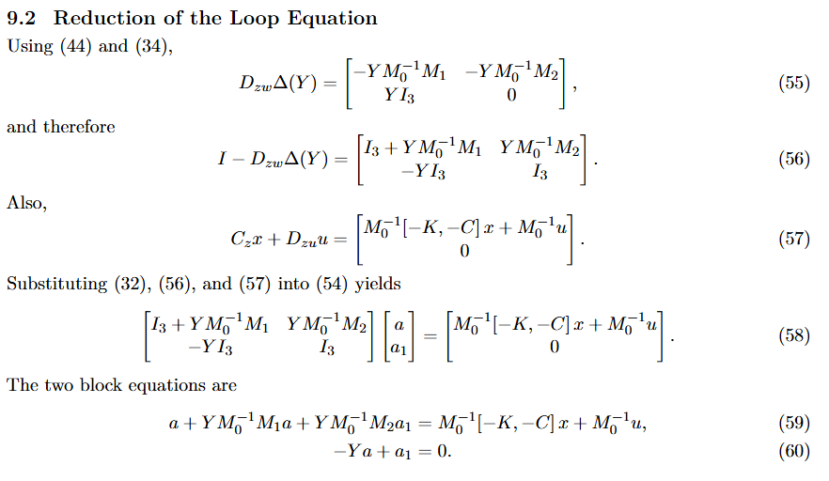
LPV-LFR derivation

Slide 30
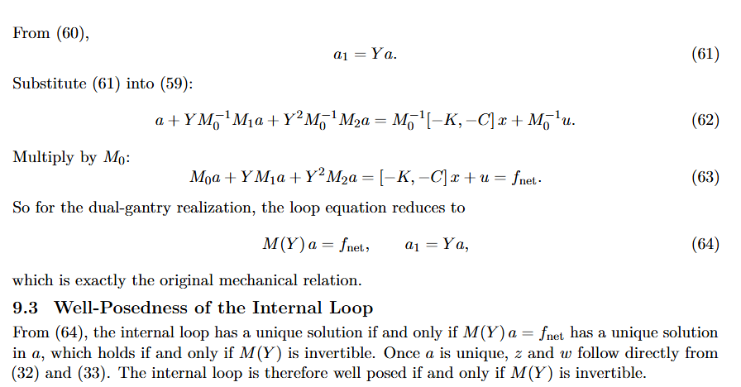
LPV-LFR derivation

Slide 31
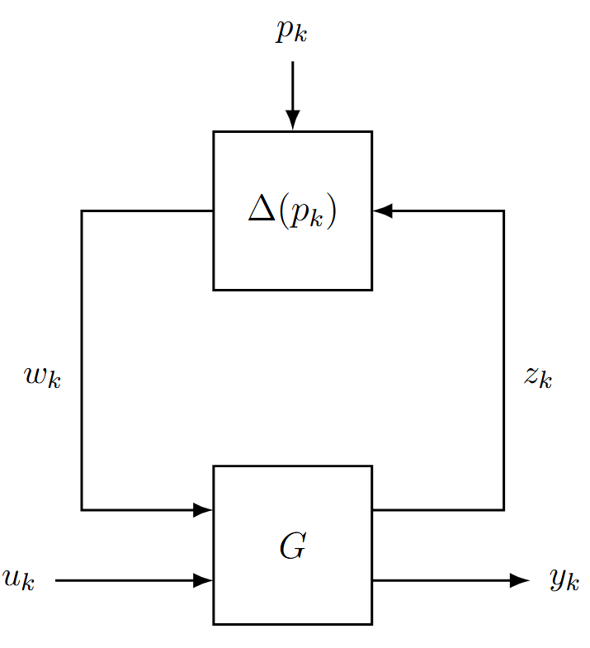
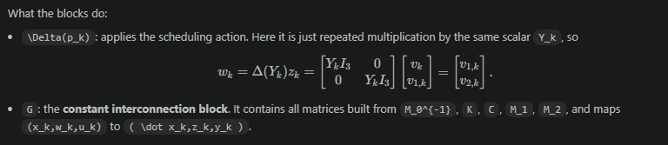
Y is the payload’s single-axis position
Y does not include x,y,z; it is only the coordinate along the Y-axis

Slide 32
LPV-LFR structure
Symbol | Meaning | Gantry
p_k | Scheduling variable | Current payload position along the Y-axis
u_k | External input | Generalized logical force input u_k
y_k | System output | Yk = qk qk = [Xk, thetak, Yk]^T
z_k | Internal output (G → Δ) | Internal signal sent to the scheduling block
w_k | Internal input (Δ → G) | Scheduled image of z_k fed back into G
Block | What it is | Gantry
G | Constant interconnection matrix: all dynamics, no P-dependence | Constant matrices built from M_0^{-1}, M_1, M_2, C, K
Δ(p_k) | Scheduling block: all P-dependence isolated here | Applies the current scheduler Y_k to the latent signals: Δ(Y_k) = Y_k I_6

Slide 33
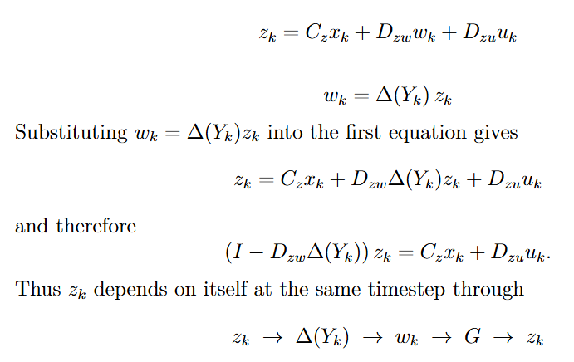
“Algebraic loop”

Slide 34
“Algebraic loop”

Slide 35
“Algebraic loop”
Loop only disappears when Dzw = 0, this is only the for the affine case. Gantry is rational.

Slide 36
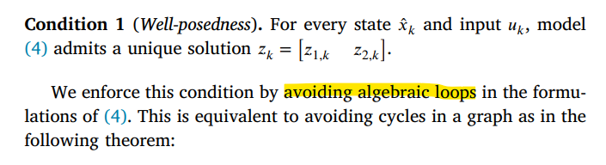
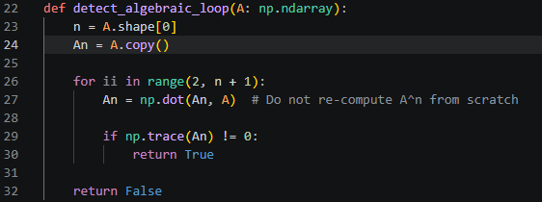
Conflict with Jan’s code
Derivation does have a unique solution, but Jan’s code does not work with algebraic loops.
Jan’s Interconnect requires acyclic signal graphs
Graph cycle detection via matrix powers: compute powers of the signal adjacency matrix A² through Aⁿ.
If any diagonal entry becomes nonzero, a
cycle exists (a node can reach itself).

Slide 37
Found it. Line 135 in interconnect.py:
assert not detect_algebraic_loop(directional
_signal_connection_matrix)
This is in init_forward() — called once
before the first forward pass. Jan builds
the signal graph as a directed adjacency
matrix, then calls detect_algebraic_loop()
on it. If a loop exists, the assert fails
hard. Let me find what that function does
The detection method is: compute powers of
the signal adjacency matrix A² through Aⁿ.
If any diagonal entry becomes nonzero, a
cycle exists (a node can reach itself). This
is the standard graph-theoretic cycle
detection via matrix powers.
The assert in init_forward() means: if a
loop is detected, the framework raises
AssertionError and refuses to initialize.
There is no fallback, no resolution — it
simply does not run.
This is not stated in the paper — it is a
hard constraint enforced in the code.

Slide 38
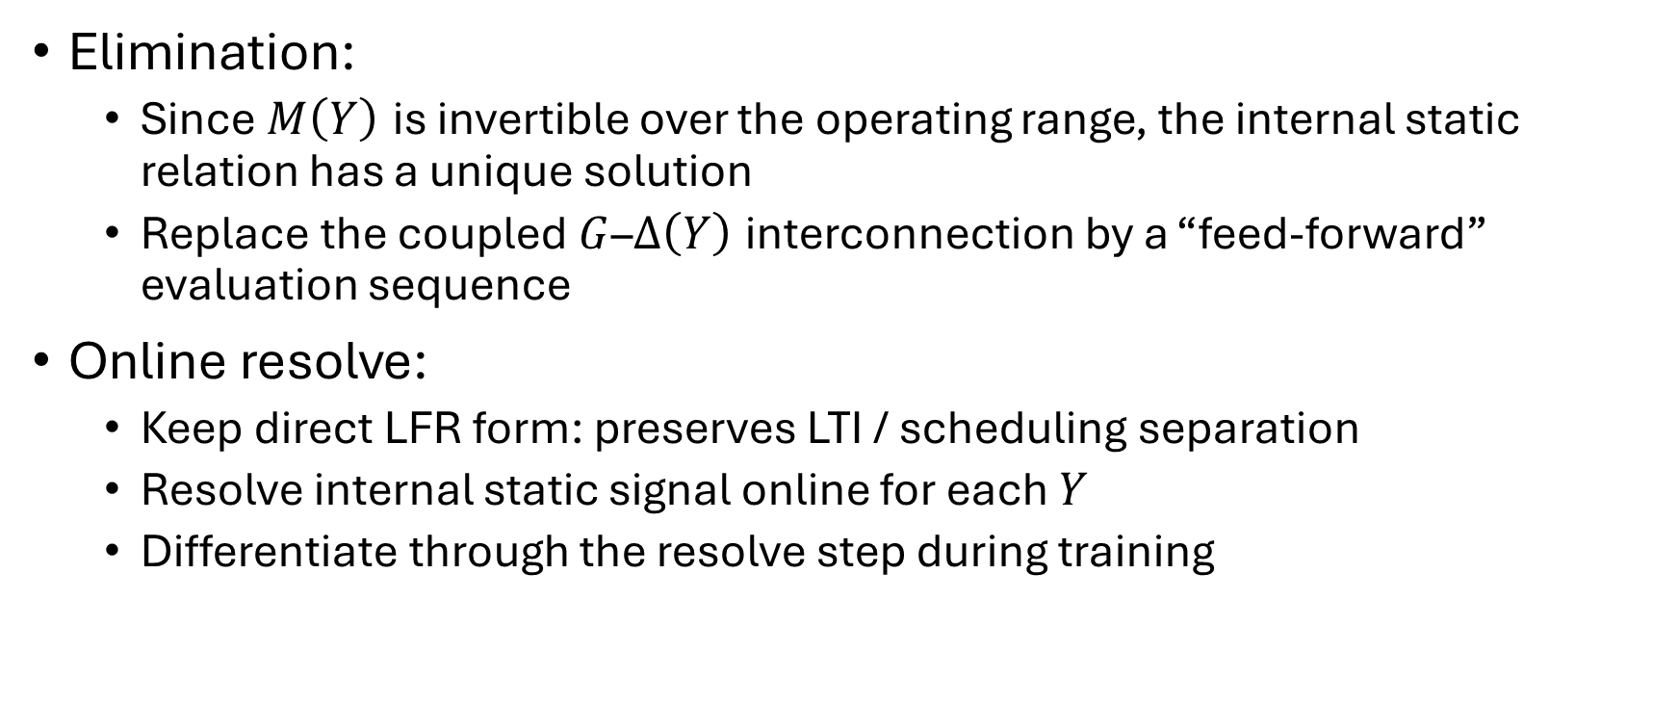
Possible Solutions
Before applying SVD for dimension reduction
Elimination:
  Since $M\left(Y\right)$ is invertible over the operating range, the internal static relation has a unique solution
  Replace the coupled $G$–$Δ\left(Y\right)$ interconnection by a “feed-forward” evaluation sequence
Online resolve:
  Keep direct LFR form: preserves LTI / scheduling separation
  Resolve internal static signal online for each $Y$
  Differentiate through the resolve step during training

Slide 39
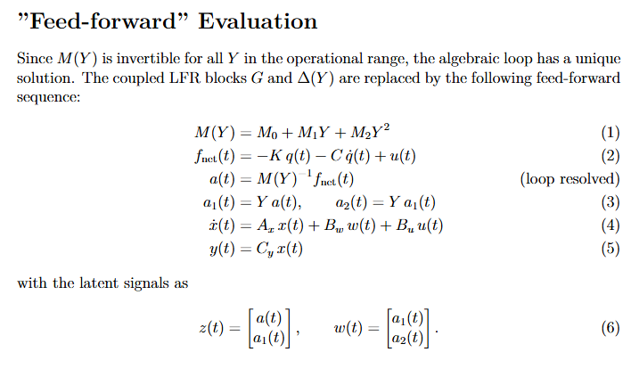
Notes:
The LFR structure is preserved because z and w are assembled
and kept explicitly as tensors at the bottom.

Slide 40
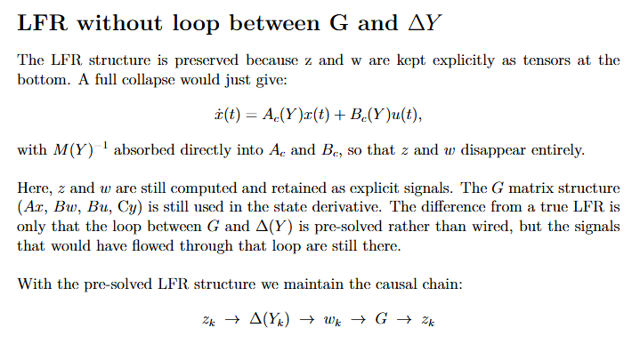

Slide 41
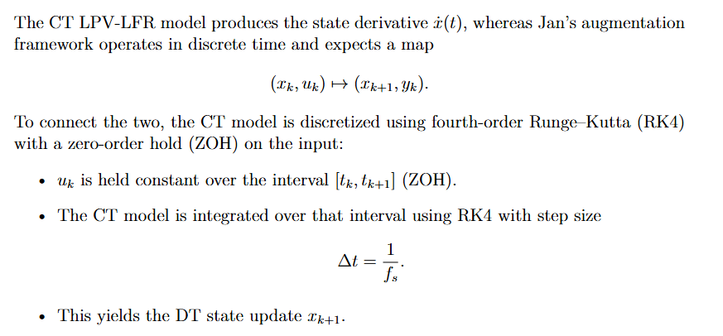
RK4 discretization in combination with augmentation code

Slide 42
The resolve-and-retain approach is the bridge: solve the
algebraic loop analytically once (producing z₁ =
M₀⁻¹(fnet − M₁w₁ − M₂w₂), which collapses to M(Y)⁻¹
fnet), substitute back, and hand Jan's framework a signal
graph with no loop. The unique solution that the LFR
guarantees is computed explicitly, and from that point
forward the framework sees only feed-forward signals.

Slide 43
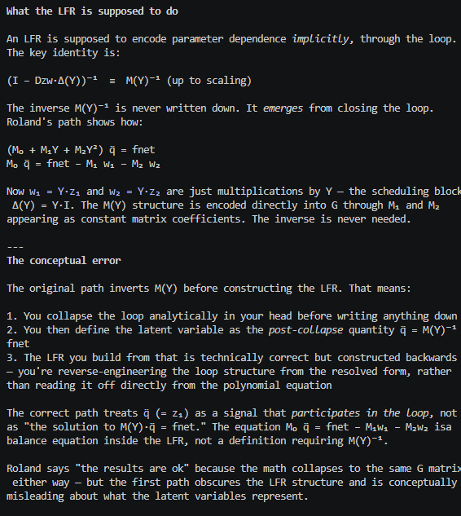
Notes from Roland
Use SVD to reduce
What is the benefit of reducing the dimensions.

Slide 44
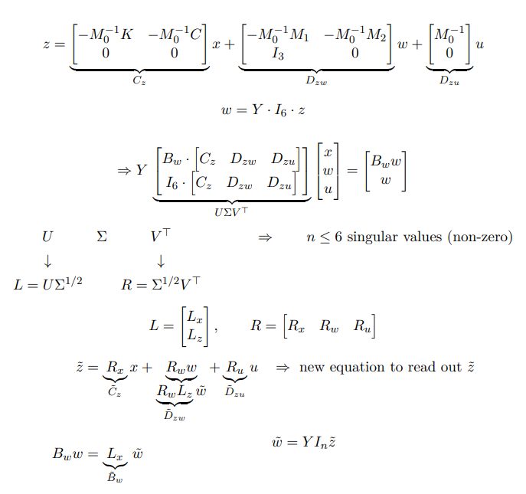
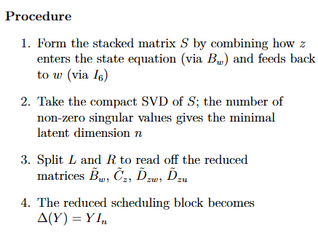
LFR-SVD – Method 1

Slide 45
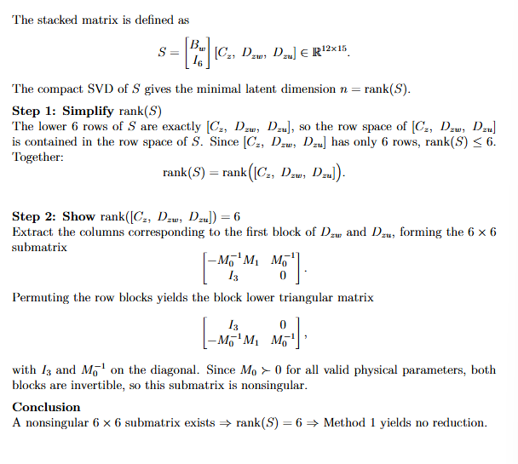
Method 1 – no possible reduction

Slide 46
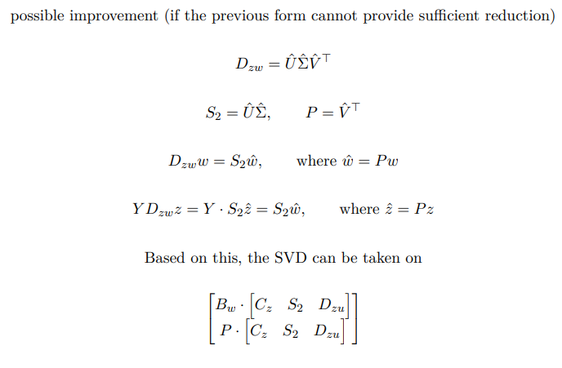
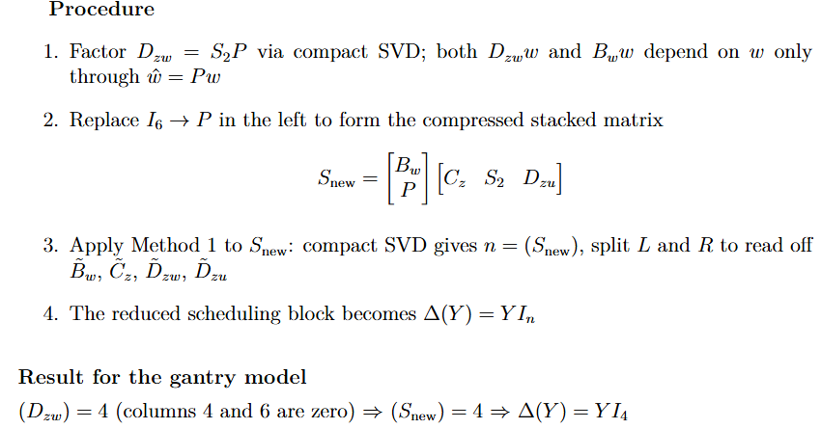
LFR-SVD – Method 2

Slide 47
Numerical validation
Implemented the SVD-based reduction in MATLAB with the physical parameters of the dual-gantry system
Verified over operating range of Y
Used the Frobenius norm for validation

Slide 48
Numerical result
rank(Dzw) = 4 (expected 4)
rank(Snew) = 4 (expected 4)
Max ||A_coll - Ac||_F = 7.97e-13
Max ||B_coll - Bc||_F = 1.72e-16
The slightly larger error for A can be explained due to two matrix inversions (M(Y)^{-1}K and M(Y)^{-1}C). While B= [0;\ M(Y)^{-1}] only involves one.

Slide 49
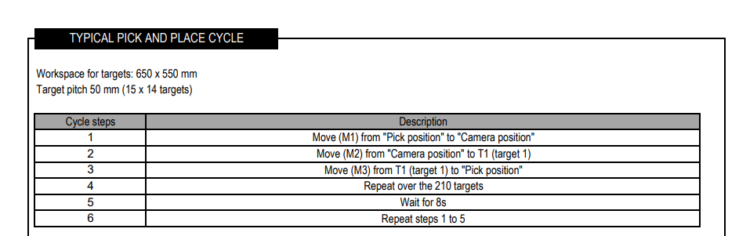
Numerical validation

Slide 50
Question 1
LPV-LFR rational problem with Jan’s augmentation code:
Would it be better to rewrite the rational LPV-LFR result into affine structure?

Slide 51
Question 2
meerdere scheduling variable toevoegen:
sign van de speed als scheduling variable meenemen
scheduling variable die de hysterese meeneemt.
of je statische wrijving verwacht volgens je
Hysteresis – note ASMPT
Additional scheduling variable?
Other notes meeting ASMPT: …
hysterese significant. als je hysterese toe wil passen, kunnen huidige structuur gebruiken?
alleen positisie meeneemt, niet genoeg om directive van hysterese mee te nemen
over na denken om wel of niet mee te nemen, kan het model dit representeren?
hysterese --> niet een model wat altijd heel nauwkeurig is
als helemaal niet meeneemt, kan zijn dat network daar heel erg op gaat fitten

Slide 52
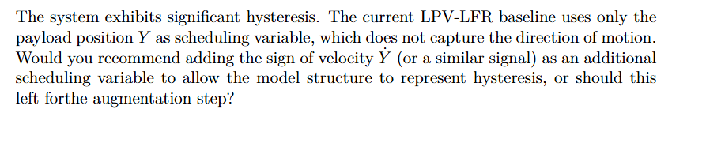
Question 2

Slide 53
Outline next week
Implement in simulation
  Elimination method
  Apply with and without SVD method
  Implement feed-forward (rigid-body)

